Slide 1

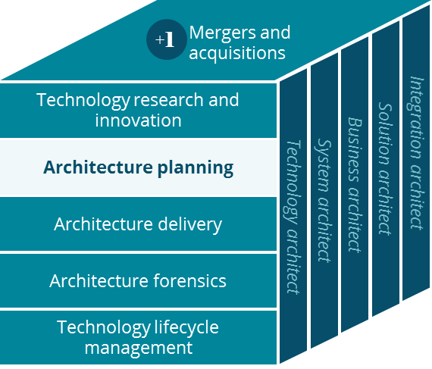
SSI Senior Supplemental Insurance Business Canvas
Architecture Planning
Peter Cram
September 2019

Slide 2
Senior Supplemental Insurance Business Canvas
Holistic view of the current SSI business model
Key Partnerships
Key Activities
Value Proposition
Customer Relationships
Customer Segment
InsPro Technologies
Underwriting
Medicare Supplemental secondary insurance for subscribers of Medicare Part B & Part A coverage.
Member primary relationship is with their Agent. Agent assisted shop-buy-enrollment. A&H claims by individual members often submitted via agent.
Consumers enrolled in Medicare seek secondary coverage. Base Medicare pays 80%. Medicare Supplemental Insurance the remaining 20%
SG Policy Administration Solutions Group
Medical Review of claim
Milliman Medical UW
Agent sales channel support, commissions, recognition
Differentiated by flexibility of benefit: Voluntary supplemental benefit insurance: coverage of Dental Vision Hearing, Home Care, Recovery Care; and indemnity coverage of events: hospitalization, cancer, heart attack, stroke or end-of-life.
Change HealthCare
Individual consumers, employees and seeking Health and Accident (A&H) plans so called ‘voluntary’. Examples include hospitalization; heart attack or cancer)
RedCard
RR Donelley
Key Resources
Service contact center is by phone
Ensurem-AAA
Vantiv
Under Writers
Channels
Case Managers Medical Review
Information Technology
Agent portal, mobile:
AQE Aetna Quote & Enroll
Carrier International
Carriers: seek administrator of similar plans, a 3rd party TPA service arrangement
Financial Stability
Agent / Brokers
Brand Recognition
AetnaSeniorProducts.com
AAA Ensurem
Cost Structure
EDI claim and eligibility
Fax enroll & claim submit
Phone service and inquiry
Correspondence
Sales, external agent commissions, recognition and supporting marketing.
Claim payments
Enrollment workflow including underwriting at times including medical review.
Protect Series manual claim medical review.
Revenue Streams
Premiums
Administrative fees as TPA - ASO
IT tools and consultants
External vendor partners
Notes:
SSI organizationally reporting structure as a self-sufficient unit within Medicare business unit, Government Service, Insurance Business Unit of CVS Health.
Acquired from GenWorth in 2011, Aetna managed SSI as a wholly owned affiliate business unit.
The information technology staff is aligned with the SSI business unit, a group of approximately 20 report solid line to Insurance IT Delivery but for all practical purposes a very strong dotted line to the SSI business and their operations.

Slide 3
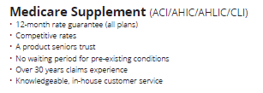



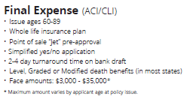


Senior Supplemental Insurance
Product descriptions - 2019
800,000+ members
Notes:
Differentiating the Medicare Supplemental product from Medicare Advantage plans is an extensive topic. The fundamental difference:
Medicare Supplemental is a secondary coverage where the primary coverage is base Medicare Part A or Part B or both;
Medicare Advantage is private insurance characterized as “Medicare Part C” and may be combined with a pharmacy coverage benefit yielding: “MAPD”; A third product “PDP” is a standalone plan covering pharmaceutical coverage benefits for prescribed drugs categorized under Part D formulary.
As of mid-2019 the Aetna Senior Supplemental Product membership:
MedSupp: 800,000 + and growing at 24% per year
Final Expense: 30,000 members
Protection Series: 180,000+ members and growing.

